Slide 1
Anonymous Dublin Core Profiles for Accessible User Relationships with Resources and Services
Liddy Nevile
La Trobe University
Australia

Slide 2
Summary
This paper argues for a resource that is
a private (anonymous) record of personal accessibility needs and preferences expressed in a Dublin Core format.
The record, identified by a URI, and title, description etc., supports an ‘accessibility’ relationship between a user and a resource.
It assumes a new Dublin Core term dc:Adaptation.

Slide 3
Summary (in other words)
This paper argues for a metadata record (of a user’s personal accessibility needs and preferences) to be described in a metadata record that will be matched with another metadata record (of a resource’s accessibility) until it can be predicted that the user of the resource will actually be able to use it.
(Is this a call for a metadata application profile of a metadata application profile? Eek!)

Slide 4
Introduction
What do we want to achieve?
Flexibility with respect to resources and services so everyone can use them.
Let’s see what TILE does:
http://inclusivelearning.ca/tile/

Slide 5

TILE
E-learning environment that enables learner-centric transformation of learning content and delivery
    Authoring support for transformable content and Metadata
    Browser
    Learning Object Repository
    Learner Preference System

Slide 6
Notes:
Suppose I am trying to learn about metric systems but I don’t like maths so I don’t like what look likes maths - just tell me what I need to know….

Slide 7
Notes:
But my friend is ‘worse’ - she hates earning hard things alone….

Slide 8
Notes:
So she likes to work with her pals …and talk about what she has to learn …

Slide 9
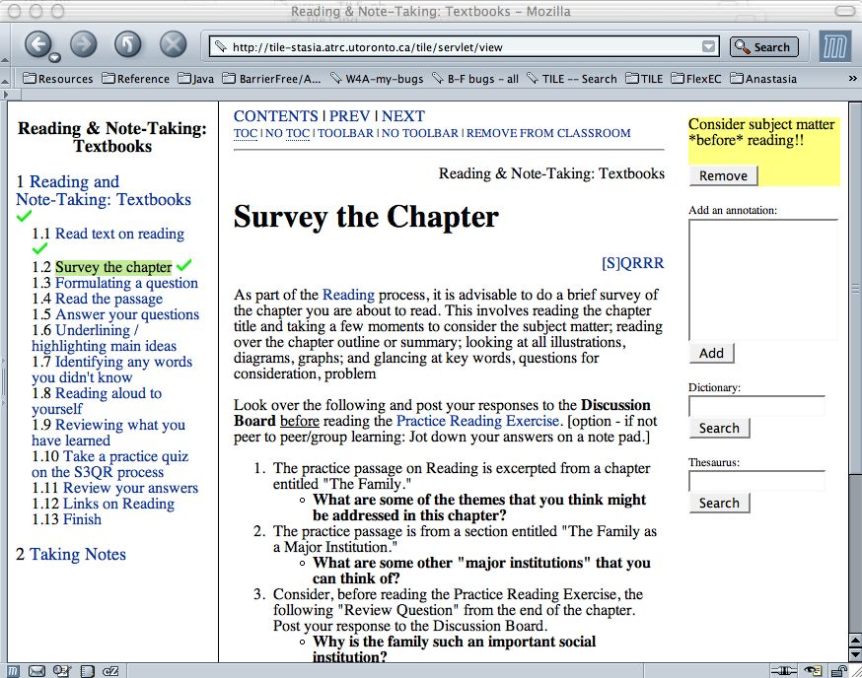
Notes:
But her big brother is a real studious type …

Slide 10
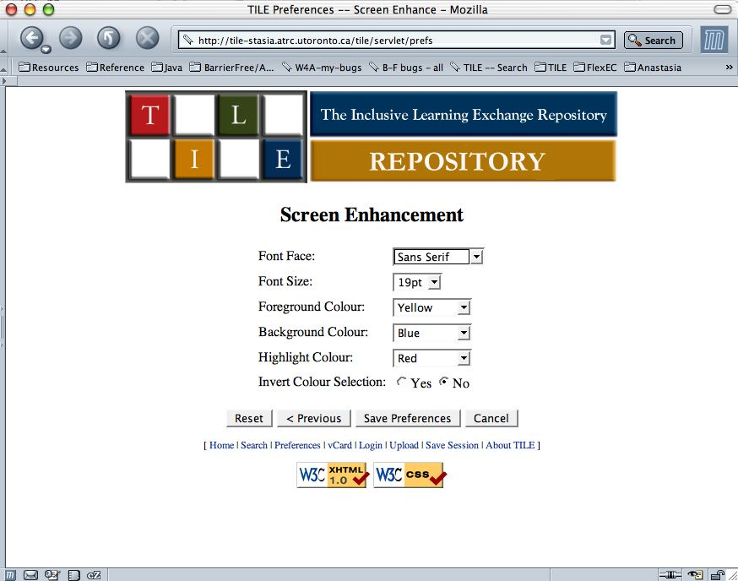
Notes:
Only problem is that he has a vision impairment

Slide 11
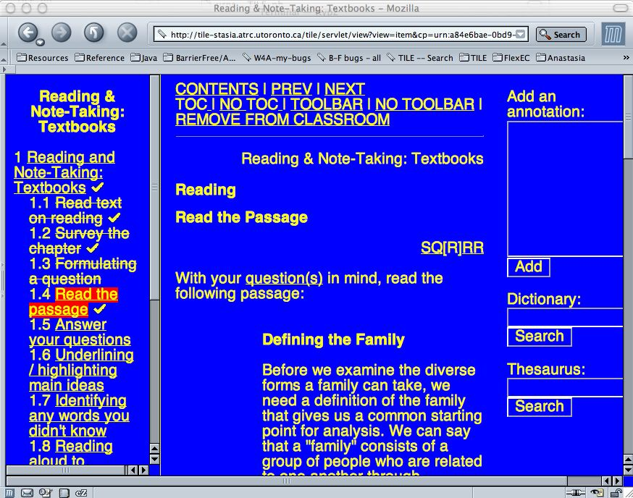

Slide 12
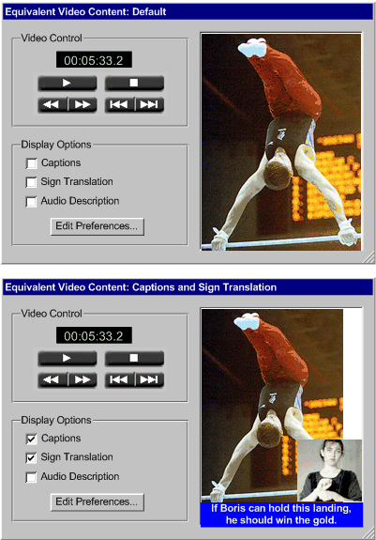
Notes:
But t’s not as bad as his friend’s problem - he is deaf

Slide 13
Notes:
So he needs captions if he cannpt get sign language which is what he prefers

Slide 14
So what’s happening?

Slide 15
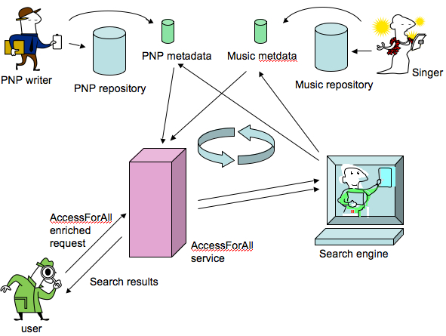
Notes:
So what’s happening?

Slide 16
Multiple PNPs
The user’s descriptions of their needs and preferences, will be used according to the context or circumstances and may differ according to the occasion.
Users will want to store and refer to such profiles rather than to create them afresh every time one is required.
Notes:
disabilities change eg when when users move from one location to another, when they change device and when they get tired.

Slide 17
Why is anonymity necessary?
We have been thoughtful about how we describe people who have the inconvenience of a disability for some time now.
We do not need to describe people by their disabilities.

Slide 18
Defining disability
The European view of disability, adopting the words of the World Health Organisation, is broad and inclusive.

Slide 19
“Disability is not entirely an attribute of an individual, but rather a complex social and environmental construct largely imposed by societal attitudes and the limitations of the human-made environment.
…. it is the collective responsibility of society at large to make the environmental and attitudinal changes necessary for [everyone’s] full participation in all areas of life.”

Slide 20
Blind or driving?
Blind people don’t drive but blind people and drivers share a common disability – they need to avoid the use of their vision for accessing resources.
Notes:
Both users will want vision-free access to the resource.
Both users will need alternatives to visual content contained in the primary resource they seek and both will want to control their access to that resource using non-visual techniques.
A simple description of the relationship they seek with the resource will be of a non-visual relationship.

Slide 21
Shades of grey
Sometimes there is a need for a special visual relationship - e.g. larger font-size
It is not non-visual but qualified visual: the text and images need to be enlarged.
Flexibility requires a common way to describe the sizes of text and images so that the necessary accessible relationship can be indicated by the user.
Notes:
Some cases need replacement or augmentation not transformation, e.g. for a non-auditory relationship with a movie when a text transcription of the background sounds might need to be supplied with captions for all speech.
Where the only problem with aural content is the choice of language, only captions will be required.

Slide 22
Mobility and Disability
Human mobility is increasing.
Mobility happens at a global and a local level: people travel between countries and contexts and between work and homes in new ways, often not actually attending a workplace.
As people move from one location to another, they often change context in ways that can adversely affect them.
Notes:
People with traditionally recognized disabilities are becoming more mobile as are their peers, so the need for public facilities to be more adaptable is increasing.
In addition, they move across communications devices with on-going expectations for similar services and facilities, including expecting that single resources will make the transition with them.
A French person arriving in Spain may find information resources being presented in Spanish inaccessible while they may wish to be given the weather report for their new location. They may, however, want to know about the weather they have left behind. It is not clear that location-based services should always account for the physical location of the user.

Slide 23
Context dependency
Location-dependent or independent?
Device-dependent or independent?
Notes:
Imagine the Spanish speaking user traveling in China who got info from the web while they were still in spain - it is suddenly inaccessible to them. Imagine the traveler in Spain who wants to know how to get a taxt from their lpcal airport when they arrive back n their home town.

Slide 24
Accessible resource components
The provision of resources and services that ensure the correct accessible relationship for a user depends upon the existence of many components all with appropriate accessibility characteristics.
They may be distributed.
Notes:
Captions are made by caption houses: Signing is usually done by specialists ie a source other than the original publisher of the resource.

Slide 25
Accessible resource components
All that is necessary is that the components are available just-in-time for delivery to the user.
Notes:
In other words, the components that may be required to complete an accessible relationship with a resource or service are often distributed and may be the result of cumulative authoring.
Very often, as is obvious from the examples already given, they may be combined in different ways for different user/resource relationships. This means it is most convenient to not fix them to a particular relationship with any one resource, but to maintain them separately and make available the necessary metadata for them to be fetched when needed. The same metadata can be used to identify a need for more components in anticipation of a demand for them.

Slide 26
The definition of accessibility
the accessible relationship between the user and the resource enables the user to make sensory and cognitive contact with the content of the resource.
This is the AccessForAll definition:
see http://www.imsglobal.org/accessibility/
Notes:
This is expected to occur at the time of accessing the resource or, in other words, to be achieved just-in-time. This is the definition being advocated by the IMS Global Project’s Accessibility Special Interest Group and supported in a growing number of communities.

Slide 27
The need for metadata
Metadata is needed to arrange the final composition of the resource.
(Note that W3C is working on related issues in their Device Independent Working Group, see http://www.w3.org/Mobile/CCPP/ )
Notes:
This implies, of course, a need for a way of communicating the requirements, or the metadata with vocabularies and common specifications for their description.

Slide 28
Relationship Descriptions
So how do we describe sensory and other accessibility needs and preferences?
We have opted for display, control and content as the three relationships that can change.
Notes:
In a library, one may be able to listen with headphones but asked not to use voice input; in a car, general auditory output may be acceptable and voice input may be essential.

Slide 29
Sensory needs and preferences
I can’t see now
I like Braille but screen-reading is OK
I can’t see well now
I may have an epileptic fit if I see flashing
I read (Braille) slowly and may need extra time
Notes:
If I can’t see, I need visual content replaced but if my eyesight is bad, I may just need bigger letters….
Particularly for people for whom settings are crucial to their engagement with resources, needs and preferences are required. If a need cannot be fulfilled, their preference for what to compromise can make all the difference. For others, if flexibility is possible, it can mean greater satisfaction.

Slide 30
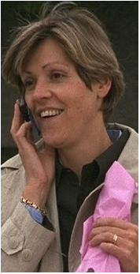
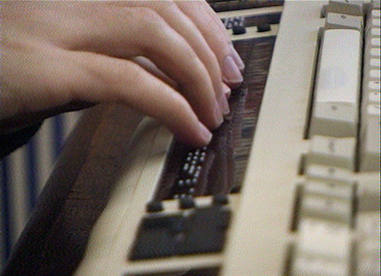
Adapting to all devices
Notes:
One of the early ‘catch phrases’ used to describe accessibility was ‘device independence’.
The idea was that is a resource could transform itself to fit the device, then everyone would get access to the same resource - and this is very important to people but especially those with disabilities who do not like to be treated differently from others.
Device independence is still a useful term but we have changed how we use it because now everyone has different devices, even many of them.

Slide 31
Adaptive technologies
Some replace standard technologies and some have special requirements.
Many have features users like to use.
In addition, there may be requirements for other display characteristics, and there may be separate needs for content adjustment.
Notes:
In the case of an on-screen keyboard being used, the display characteristics of the resource also will need to be adapted to allow for the loss of screen space for display purposes.
control needs and preferences may mean settings for their personal adaptive technology, so we need to allow for generic and application-specific settings.

Slide 32
Adaptive technologies
Some requirements can conflict, eg an on-screen keyboard and a ‘full-screen’ resource.
For this reason, descriptions of needs and preferences for display, control and content characteristics need to be separated.
Notes:
The needs and preferences need to be easily describable, so it is essential that if there are no special needs, nothing needs to be described, but that when there is a need, there is a hierarchy of details that are easily understood and useful.

Slide 33
Display descriptions
Where the person can’t see text, it may need to be transformed into another mode - aural or tactile (Braille).
Text may need to be bigger and a different colour.
Images may need to be bigger.
Notes:
Where the adaptive technology does not change the mode but changes the characteristics of the display, as in the case where screen-enhancing software is being used, the requirements for the desired display may involve object sizes, colour, or placement on the screen.
The requirements can be very detailed and vary depending on the circumstances. Changes in the mode of content, as occur when a screen reader renders visual content (text) as auditory content, may depend upon it being possible to transform the content in this way. This in turn will depend upon the form of the original content: it can be transformed easily unless there is formatting, for example, that interferes with the process. The ‘transformability’ of the text will need to be described if it is relevant to the user’s relationship with the text.

Slide 34




Slide 35
Control descriptions
Some assistive technologies effectively replace the typical mouse and keyboard combination without any adjustment
but others use technologies that require special configuration.
An on-screen keyboard will use screen space e.g.

Slide 36
Content descriptions
A dyslexic person may need additional images to avoid excessive text
a ‘foreigner’ may need an alternative language
a eyes-busy person may need a text description of an image.
Notes:
The relationship between a user and a resource or service will also be accessible only if the content is perceptible by the user. It is often the case that the original content has to be supplemented, perhaps with the availability of a dictionary or captions, or replaced by different content that achieves the same outcome but in a different way.
Information about the resource that indicates that it contains such alternative content, or the location of such content that is available externally, is needed to determine if the user will be able to form an accessible relationship with it in terms of perception.

Slide 37
Personal needs and preferences
Information about the user’s needs and preferences is required by an accessibility server.
It may need to be very detailed and
it may vary according to the circumstances or context.
Notes:
The control settings for a user may be detailed and it is often not practical for the user to establish them every time they are used, even if they are able to do this themselves.
Details regarding the desired language of the content, the complexity, style and illusory level of the language used, and its cultural dependence, can be critical to accessibility.

Slide 38
Web-4-All
a smart card has the necessary information about a user’s settings for adaptive devices and software available within a device.
The computer establishes the correct control relationship between the software and the user and resets the computer when the user’s card is withdrawn.
See http://web4all.ca/

Slide 39
PNP* application profile
To match a resource or service, there is no need to identify the user.
All that is required is identification of machine-readable information about their needs and preferences.
*Personal needs and preferences
Notes:
Users may like to think of profiles as being associated with certain contexts, for instance the lecture theatre version, or the JAWS lap-top version, and in such a case the profile could be named. So we could find DC:title being used for this. The application profile may contain more DC elements, such as DC:subject, DC:description, DC:creator, etc. None of these need identify the user for or by whom the AccessForAll information will be used. They may, on the other hand, clarify who could take advantage of the profile: for instance, all students in a lecture theatre will probably share the need for large print on the overhead screen. This could be explained in a DC:description element. It may be of interest to know who developed the user needs and preferences profile, so DC:creator could be used to indicate this. The date of a profile might be significant when new versions of adaptive software are released so DC:date may be useful.

Slide 40
AccessForAll (A4A) vocabularies
The DC Accessibility Working Group (in collaboration with the IMS Global Consortium and others) is working on an application profile for describing accessibility of resources.
Surely best practice is to use the same vocabulary for user’s needs and preferences and resource characteristics.
Notes:
Hopefully established DC compliant systems will be able to immediately create and use the new metadata if it is DC compliant?

Slide 41
User needs as a resource
Avoids defining people by disabilities or needs
Allows for individuals to use multiple descriptions
Allows for ‘cascading’ descriptions
Notes:
By rendering the user’s needs and preferences profile as a resource, problems associated with the politically unpopular activity of labeling people by disabilities can be avoided. The technical problem that a single person will be associated with a number of AccessForAll profiles is also avoided as they can point at different times to any of a range of profiles. In addition, where there is a need for many users to share a profile, as with students in a lecture theatre, this is easily achieved.
When a system is to be used simultaneously by two users who point to different profiles, it may depend on the circumstances how this is to be handled. If they are to share a screen, their needs will have to be harmonized. If they are working on the same application but separately, as when two remote users share a chat session, their individual needs should be accommodated.
When two users are, for example, a group with a corporation’s set of ‘needs and preferences’ that conflict with the individual’s essential needs and preferences, the latter should be matched in preference to the former.

Slide 42
Accessible publishing
Systems, rather than individual resources, achieve accessibility according to the definition being promoted in this paper.
One difference between the earlier approach and that now being offered is that one is just-in-case and the other is just-in-time.
It also changes who is involved in ensuring accessibility.
Notes:
Specifically, while universal accessibility of resources and services is always a goal and conformance to the universal accessibility specifications recommended by the World Wide Web Consortium is recognized as best practice, it is known to be unlikely to be attained on a regular basis and not as essential as actual accessibility of the user and resource relationship at the time of use ().
See eg 2005
with the use of metadata is that the latter definition allows for just-in-time provision of components to satisfy the accessible relationship and these components can be attained from cumulative, distributed authoring. The former definition, requiring universal accessibility of resources, demands just-in-case resource composition and therefore inclusion of all potentially necessary forms of display, control and content, including many that may never be used.

Slide 43
Recursive accessibility matching
The process involves having a main resource identified and then testing its match with a PNP before perhaps having to de-compose it to find an alternative to a component and to transform, replace or supplement that component, before re-assembling the resource and re-testing the resource or perhaps having already test- matched the new component..

Slide 44
Recursive accessibility matching
ummm…
The process involves delving into the components of a resource, that is, working with components and not assuming that the atomic resource is a ‘document like object’.
Notes:
Components may need to be supplemented, transformed or replaced. Providing identification of components is necessary in order to do this successfully. We anticipate (and hope for) much more use of automated metadata generation so that, eg, an image will be identified by its URI separately from the main resource without the need for human intervention.

Slide 45
Conclusion
The paper argues for an application profile for user accessibility needs and preferences, expressed as a resource.
It notes this can be of critical importance to some potential users of digital resources.
It assumes a Dublin Core element for adaptation, and co-existence with cc/pp, WCAG, EARL and other W3C specifications.
Notes:
It is hoped that by working with familiar DCMI structures and practices, systems can easily access metadata that will be used to accommodate the needs and preferences of users, most particularly those for whom use of most resources and services is currently impossible, and so make information systems much more inclusive.
While the needs and preferences to be accommodated are for people, the case avoids the use of metadata describing people and instead offers the idea that a description of the necessary relationship between a user and resources and services is simply another resource. It advocates the use of well-described profiles of user accessibility needs and preferences and opens the way for these to be generalized for classes of users, such as non-visual users, or non-auditory users. It avoids all association of disabilities and special needs with people’s identity.

